Slide 1
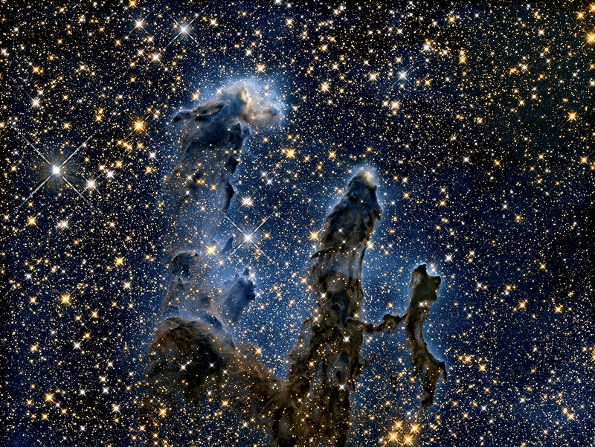
A Few Random Facts about Space
Written by David Ilsley
M1Astronomy.com/
SF-random-facts.pptx
Image: rawpixel.com

Slide 2
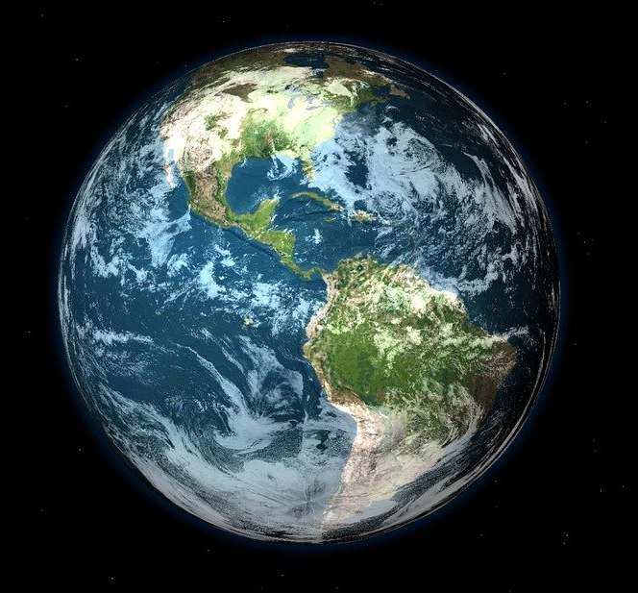
People used to think that the Earth was flat.
Some still do.
But most people nowadays know it’s round.
Image: pixabay.com

Slide 3
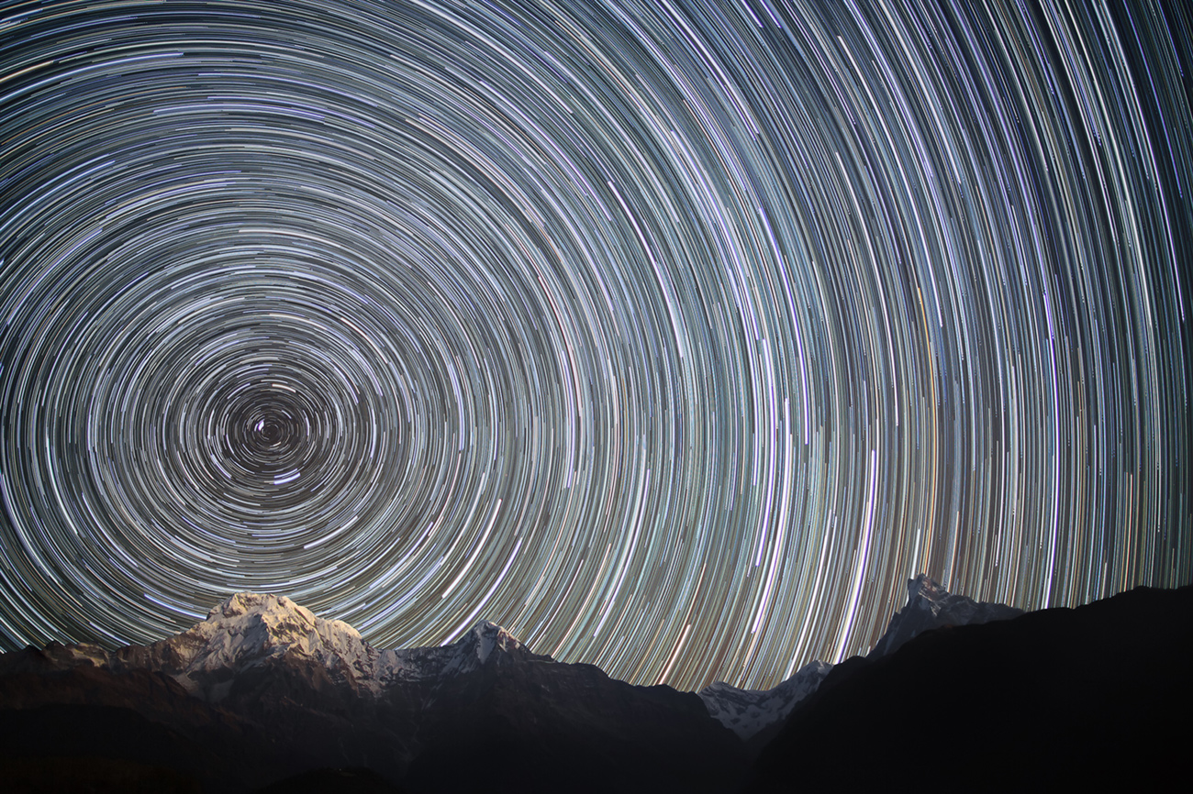
The Earth rotates.
If you stand at the pole and look up, the stars will appear to rotate about the point above you.
Image: Wikimedia Commons
The circumference of the Earth is 40 000 km.
At what speed is a place on the equator moving in km/h?
Estimate or calculate the speed where you are.

Slide 4
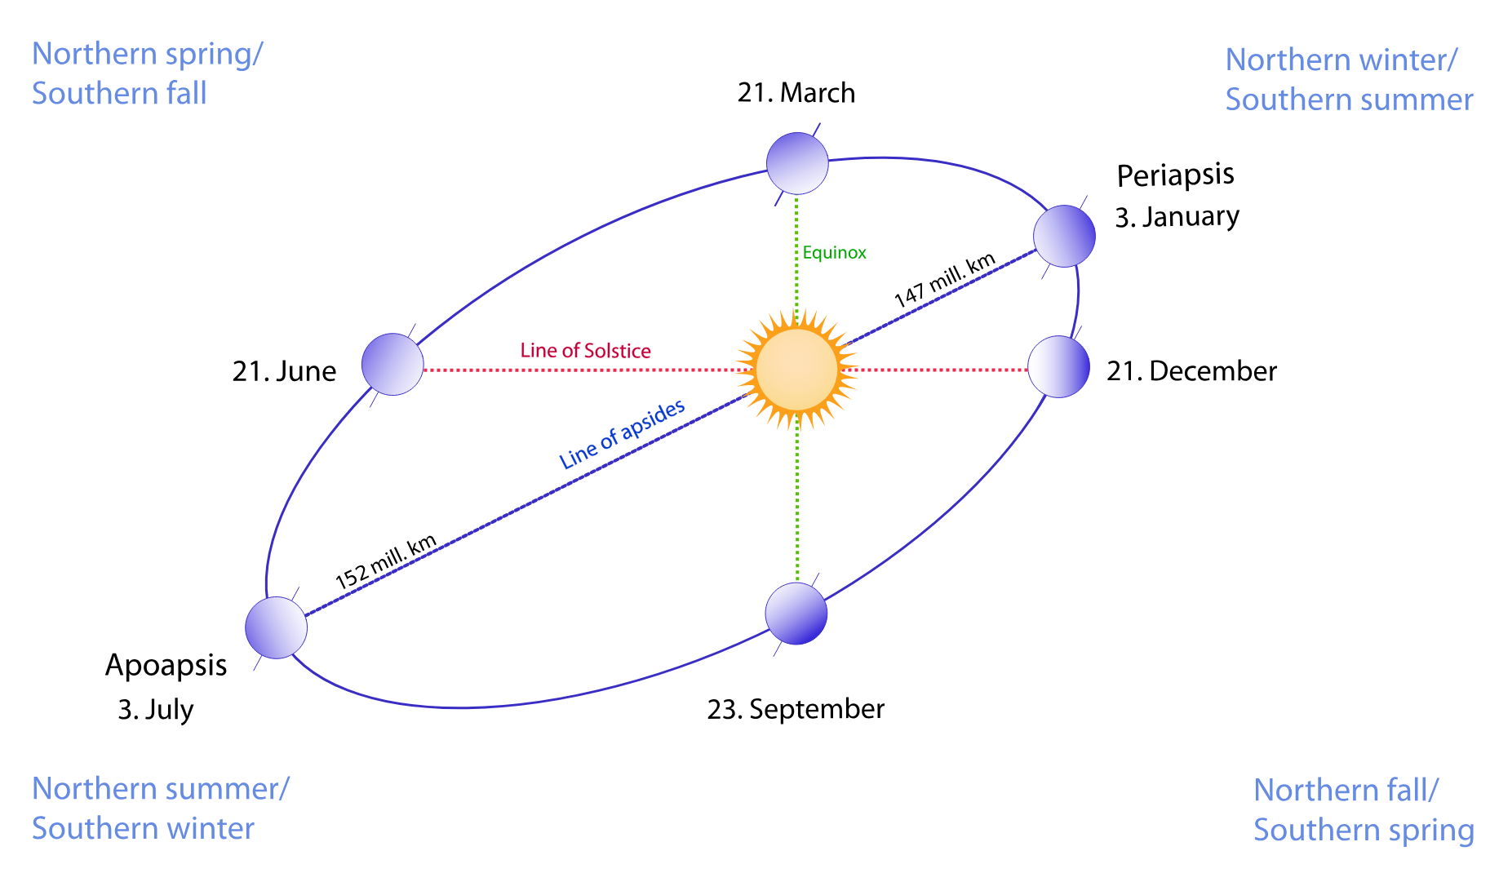
The Earth also goes around the sun about 70 times as fast as the point on the equator moves.
How fast is that in km/s?
Image: Wikimedia Commons

Slide 5
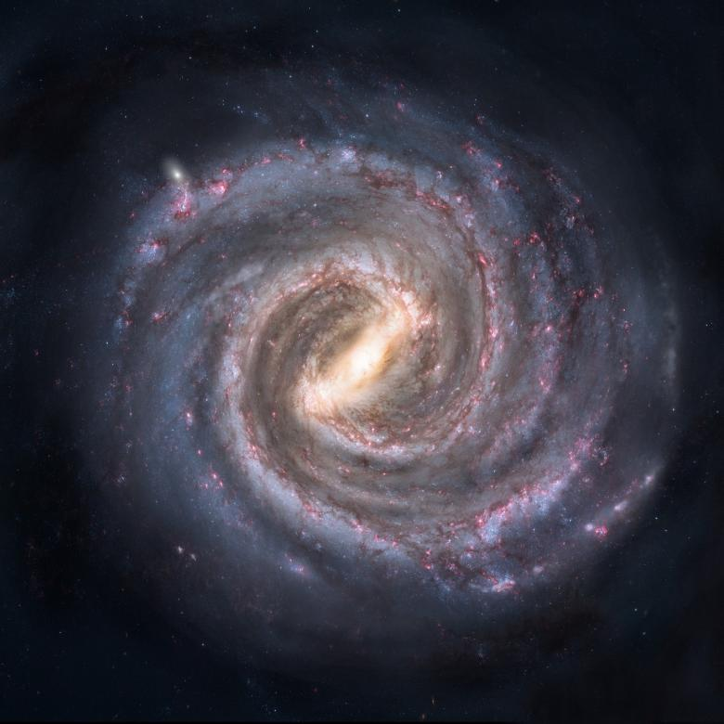
And the sun goes around the galaxy about 70 times as fast as that.
What speed is that?
How long does it take for the Earth to move a distance equal to its diameter?
Remember the Earth’s circumference is 40 000 km.
Image: Pixabay on Stockvault.net

Slide 6
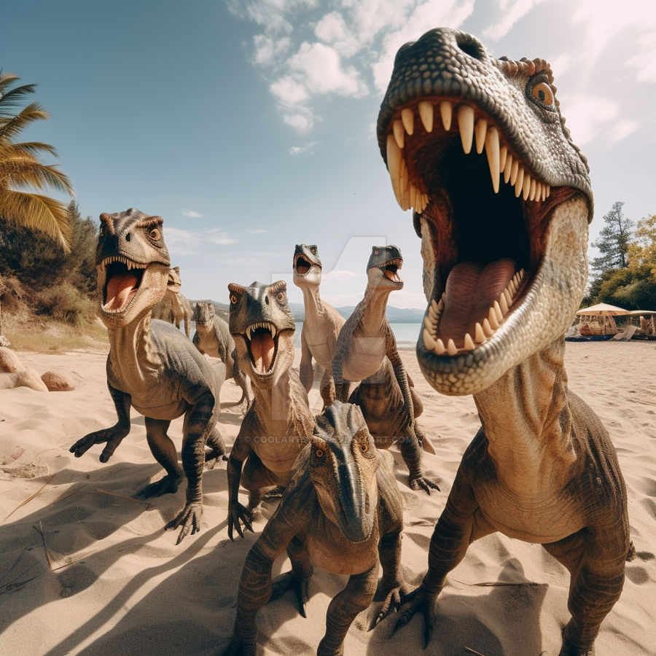
Even at that speed, it takes about 250 million years to go round the galaxy once.
So, the dinosaurs lived on the other side of the galaxy!
Image: Coolarts223 on DeviantArt
How far does the Earth travel in going around the galaxy once?
If light travels 300 000 km/s, how far is that in light years?

Slide 7
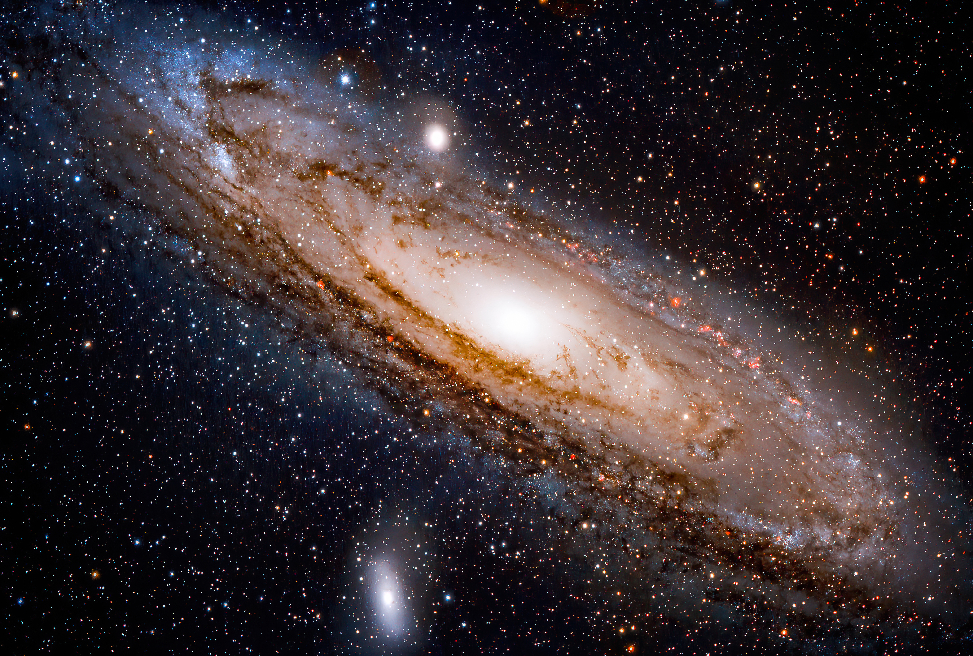
Andromeda is a bigger galaxy than our Milky Way and it’s heading towards us at 110 km/s.
It’s going to collide with us . . .
If it’s presently 2 million light years away,
how long before it does so?
Image: pixabay.com

Slide 8
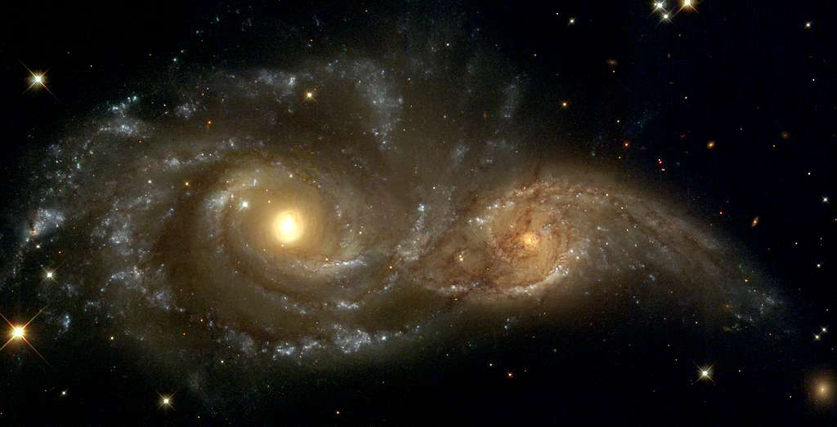
Image: Picryl
We don’t need to worry. Even though each galaxy contains around 500 billion stars, the spaces between the stars are so huge that it’s unlikely that there will be even a single stellar collision.

Slide 9
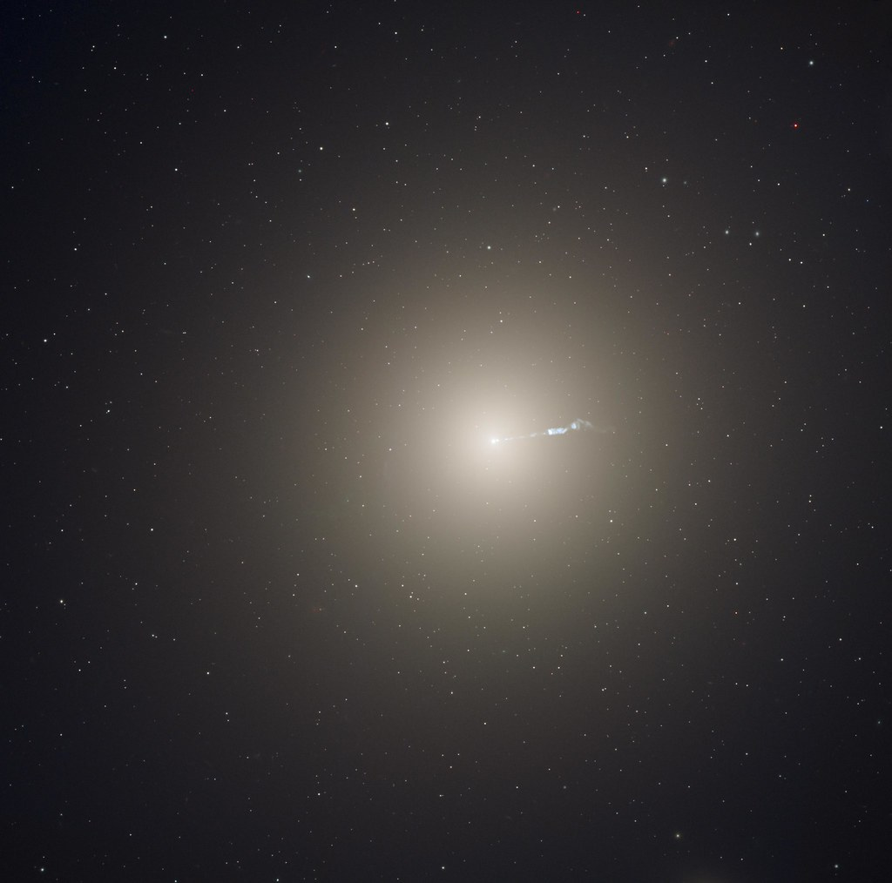
The gravitational attraction between stars, however, will cause them to change direction.
So, the two galaxies won’t just pass through each other; the two spiral galaxies will combine to form one elliptical galaxy like this.
Image: Flickr

Slide 10
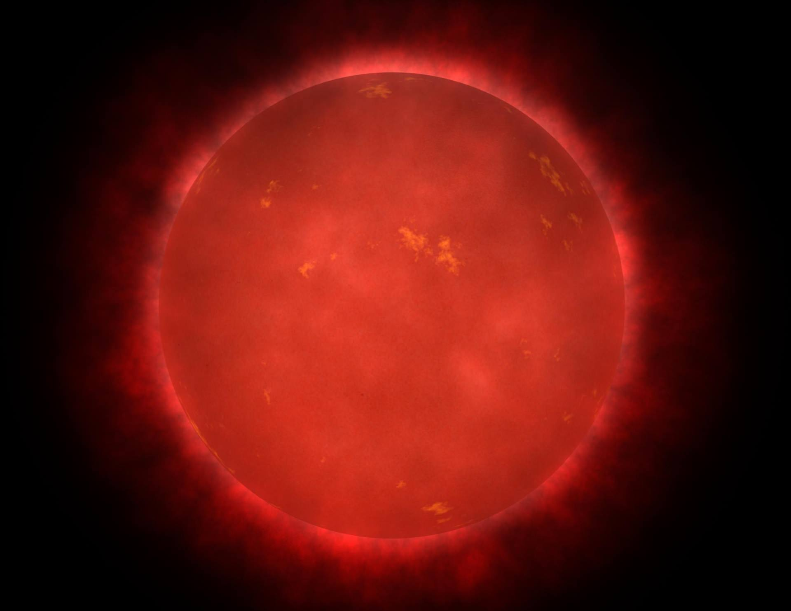
Another reason not to worry is that, by then, our sun will have expanded into a red giant and swallowed the earth anyway.
The sun will expand from 1 400 000 km diameter to
150 000 000 km diameter. By what factor will its volume increase?
Image: Wikimedia Commons

Slide 11
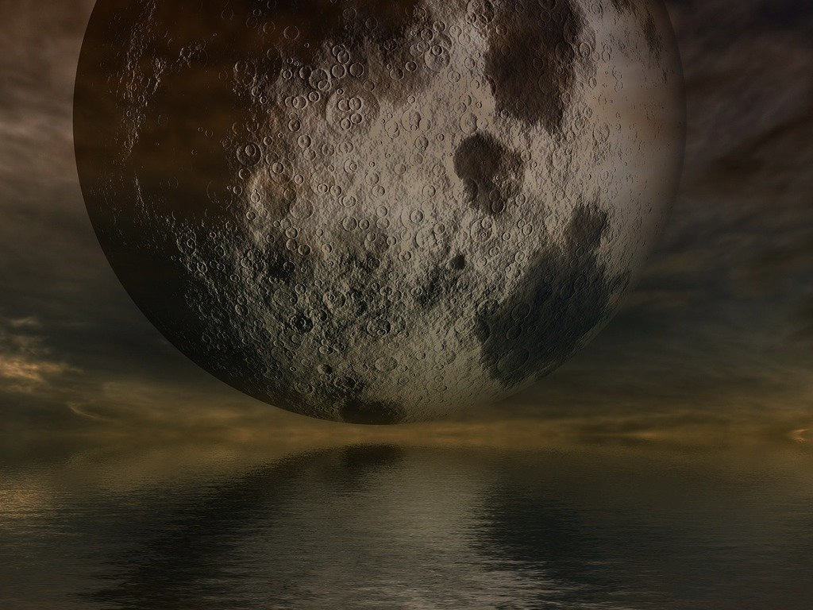
When the earth was young, 4.5 billion years ago, the moon was only ¹/₁₅ as far away as it is now. So, it was 15 times as wide in the sky and more than 100 times as bright.
How many times as bright exactly?
The moon orbited the earth in 27 hours.
There would have been a total eclipse of the sun and a total eclipse of the moon on each orbit.
In those days, the earth rotated in about 6 hours too.
Estimate or calculate how long it would have been between two successive moonrises?
Image: Pixabay

Slide 12
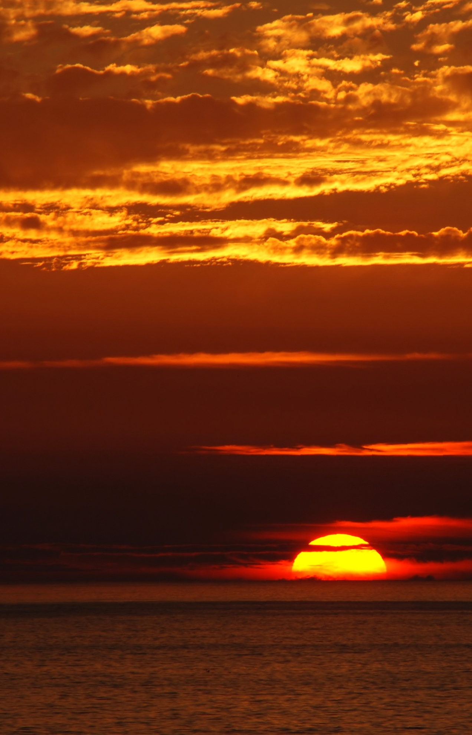
Every billion years the sun’s heat output increases by 7%.
By what percentage would it have increased in the last 4 billion years?
What percentage of its present heat output would the sun have produced 4 billion years ago?
Image: Wikimedia Commons

Slide 13
In another billion years or so, all the water on earth will have boiled away into space and that will be the end of life as we know it.
Another 4 billion years after that, is when the sun becomes a red giant and swallows us.
Image: Wikimedia Commons

Slide 14
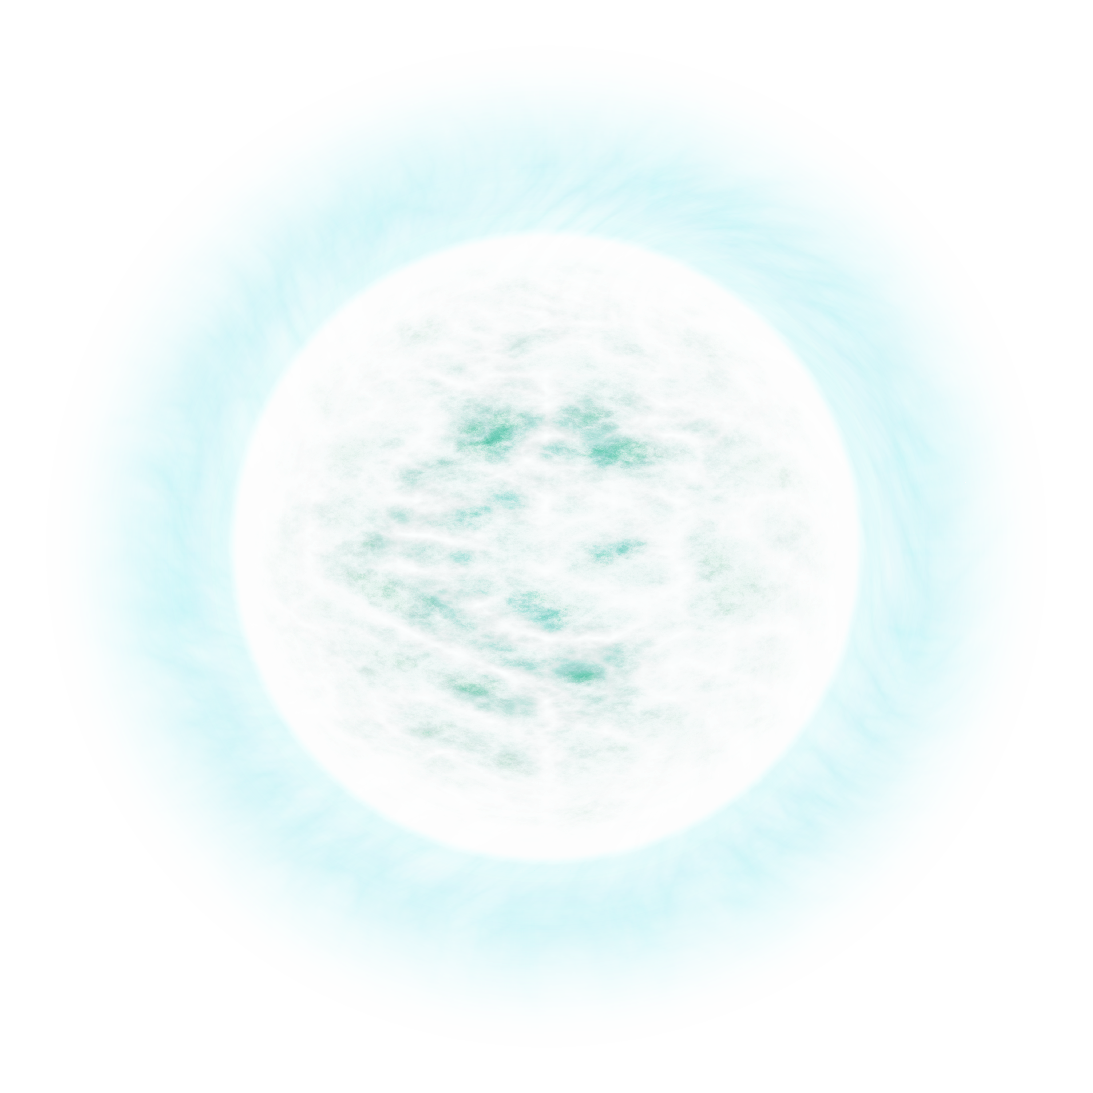
The sun will spend about a billion years as a red giant, then shrink down to a white dwarf – about the same size as the earth, about 1% of its present diameter.
The average density of the sun is presently 1.4 kg/L.
What would be the mass of a teaspoonful (5 mL) of the white dwarf?
A white dwarf is mostly carbon and oxygen and, as it cools, some of the carbon could crystallise into huge diamonds.
Image: Wikimedia Commons

Slide 15
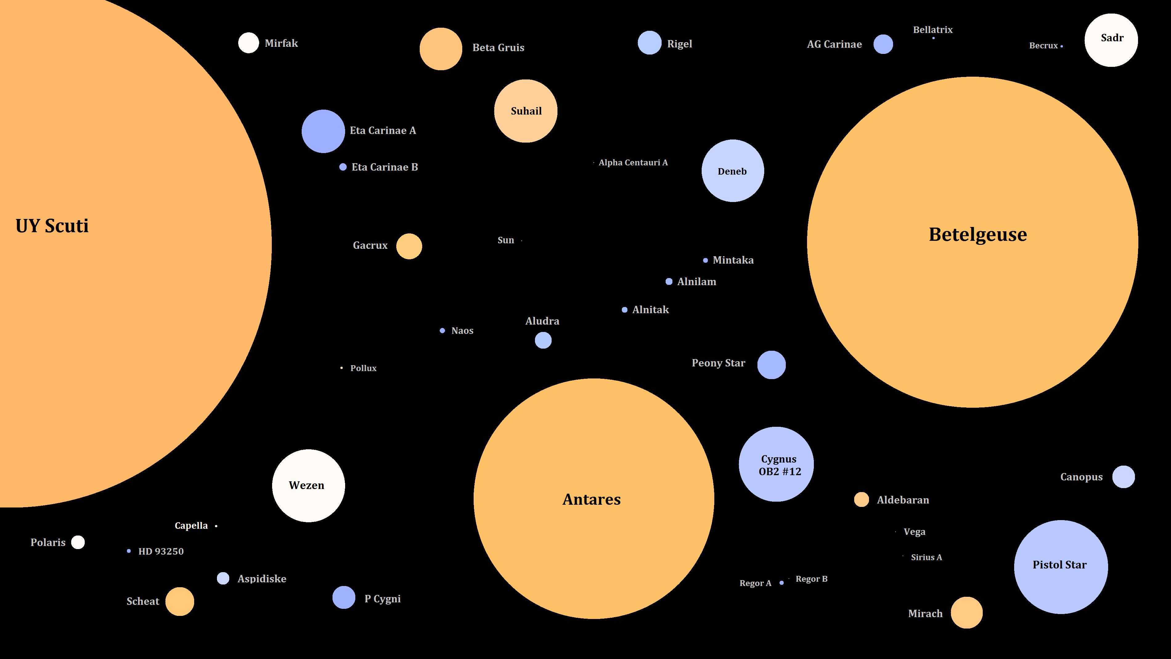
The sun is big: over a million earths could fit inside it.
But some stars are much bigger than the sun.
A billion suns would fit inside Betelgeuse.
Image: commons.Wikimedia.org

Slide 16
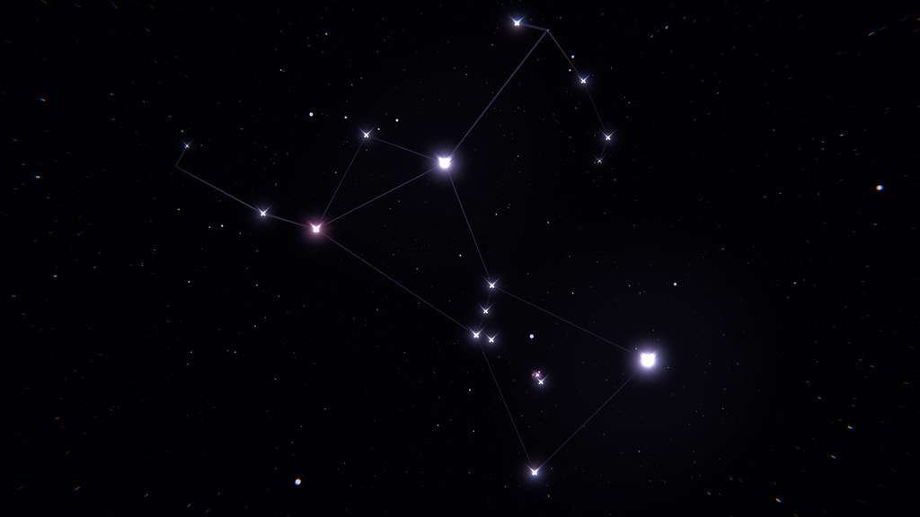
Betelgeuse is the tenth-brightest star in the sky. It is the second-brightest star in the constellation Orion.
Betelgeuse is a red giant and obviously red when you look at it. It’s tempting to think that it’s called “Betelgeuse” because the stuff that comes out of beetles when you squeeze them is red.
But it isn’t. It comes from the Arabic “bat al-jawzā”, which means “the giant's shoulder”
Image: Flickr

Slide 17
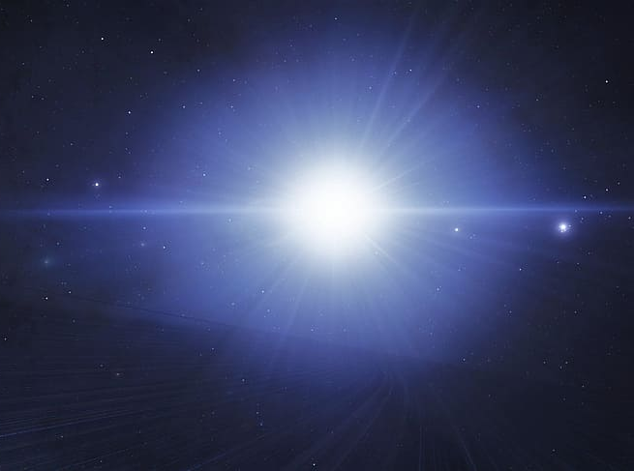
Betelgeuse is 16 times the mass of the sun.
Stars that heavy die more dramatically in supernova explosions, shining a trillion times brighter than the sun for a few days.
Image: pxfuel.com

Slide 18
The most recent supernovae in the Milky Way were:
Year | Constellation | Magnitude
1006 | Lupus | –7.5
1054 | Taurus | –6
1572 | Cassiopeia | –4
1604 | Ophiuchus | –2
For each unit decrease in magnitude, a star gets 2.5 times as bright. How many times brighter than Venus
(magnitude –4.5) was the Lupus supernova?
Betelgeuse is due to go supernova any day. When it does, being just 600 light years away, it will be over 1000 times brighter than Venus, as bright as the full moon.
What magnitude will that be?

Slide 19

What causes a supernova?
The sun gets its energy by fusing hydrogen to helium.
When it becomes a red giant, it will fuse helium to carbon and oxygen. Then it will die.
In stars like Betelgeuse, the carbon and oxygen then fuse to neon, magnesium, silicon and finally iron, each step releasing energy – until the whole core is made of iron.
Image: AI Emojis

Slide 20
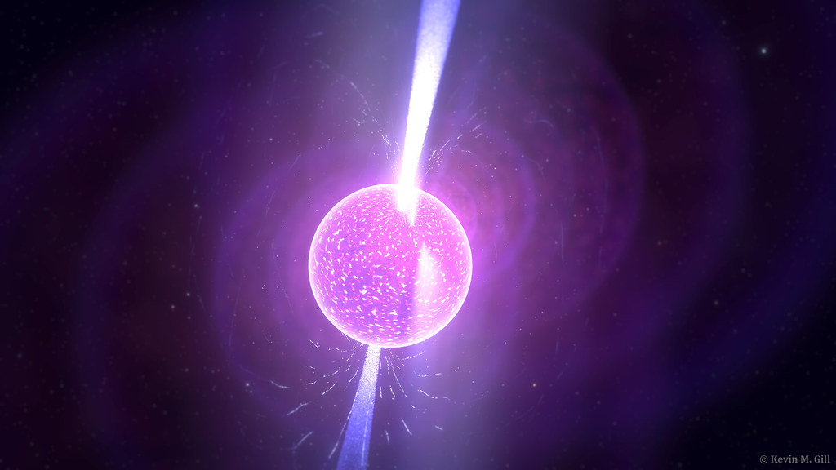
Fusing iron doesn’t release energy, so, with the energy source removed, it can no longer hold up the weight of the outer layers.
It then collapses from 20 000 km wide to 20 km wide in less than a second. The outer layers fall onto it at a quarter the speed of light, then rebound into space producing the supernova explosion.
The core is left as a neutron star, made of solid neutrons.
Image: flickr.com

Slide 21
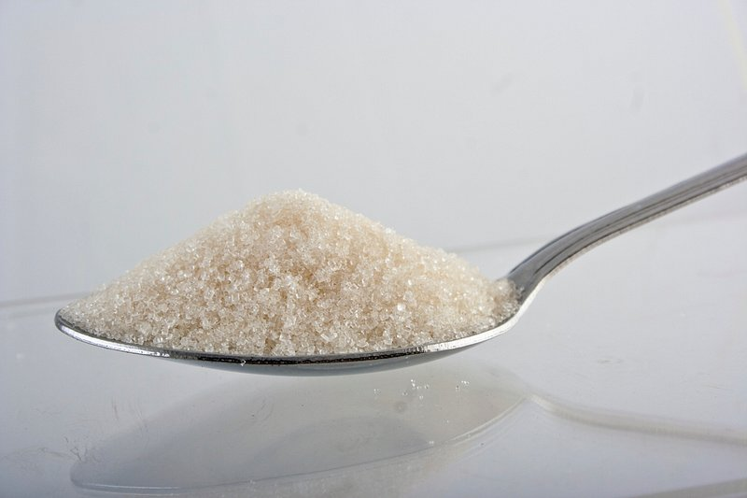
A neutron star has a similar mass to the sun, but with a diameter of 20 km instead of 1 400 000 km.
Remember the density of the sun is 1.4 kg/L.
What is the mass of one teaspoonful (5mL) of a
neutron star?
Image: rawpixel.com

Slide 22
The gravity on the surface of a star is proportional to its mass and inversely proportional to the square of its diameter.
Gravity on Earth is about 10 m/s/s. That’s how fast you accelerate in free fall.
Gravity on the sun’s surface is 30 times as much, i.e. 30 gs.
If the sun’s diameter is 1 400 000 km and the diameter of a neutron star is 20 km,
how many gs would the gravity on the surface of a neutron star be?

Slide 23
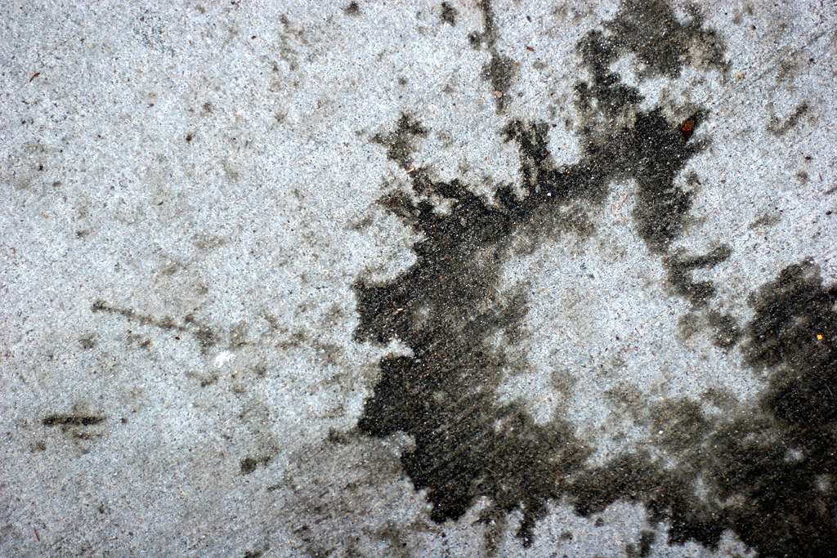
If you dropped a spanner from waist height on a neutron star, how fast would hit the ground in km/h?
You can use the formula v² – u² = 2as
Where u is the starting velocity, v is the final velocity, a is the acceleration and s is the distance travelled.
Not that you could, because you would be instantly squashed down to a thin smear on the star’s surface.
Image: Flickr

Slide 24

Ballerinas spin faster when they pull their arms in.
In the same way, when a star gets compressed down to a neutron star, it spins faster.
This is because angular momentum is conserved.
Image: Pexels

Slide 25
The angular momentum of a uniform sphere is 0.4mr²ω
where m is the mass, r is the radius and ω is the angular velocity in radians per second.
(There are 2π radians in a revolution.)
The large stars that form neutron stars tend to spin around once per day.
After the 20 000 km-wide core of such a star collapses to 20 km wide, how long would the neutron star take to rotate?

Slide 26
Some neutron stars rotate at hundreds of revolutions per second, the fastest known at 716 per second.
Assuming a 20 km diameter, what would be the speed of a point on the equator of that neutron star?
What fraction of the speed of light is that?

Slide 27
When stars more than 25 times the mass of the sun go supernova, instead of a neutron star, they leave a black hole, which is so dense that its gravity stops light from leaving its surface.
Black hole
If you fell into a black hole, that would be . . .

Slide 28
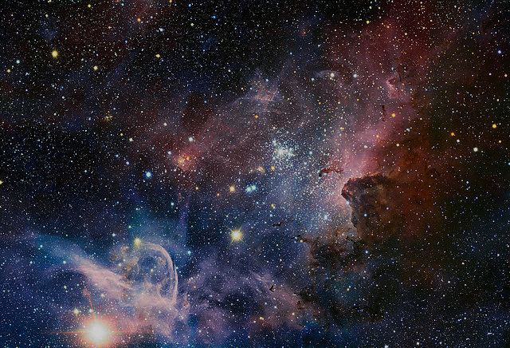
The End
Image: commons.Wikimedia.org

